Slide 1
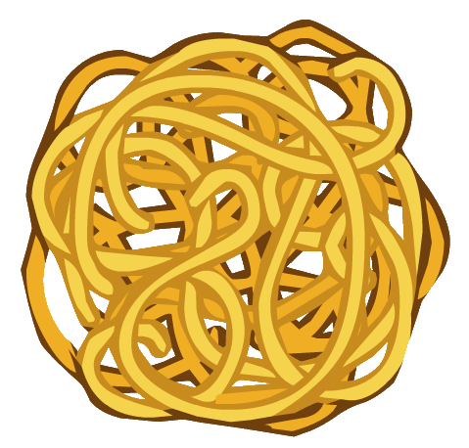

From spaghetti to reactive

Slide 2
Spaghetti code
Spaghetti code is a pejorative phrase for source code that has a complex and tangled control structure, especially one using many GOTO statements, exceptions, threads, or other "unstructured" branching constructs. It is named such because program flow is conceptually like a bowl of spaghetti, i.e. twisted and tangled.^{[1]} Spaghetti code can be caused by several factors, such as continuous modifications by several people with different programming styles over a long life cycle. Structured programming greatly decreases the incidence of spaghetti code.
From Wikipedia, the free encyclopedia`

Slide 3
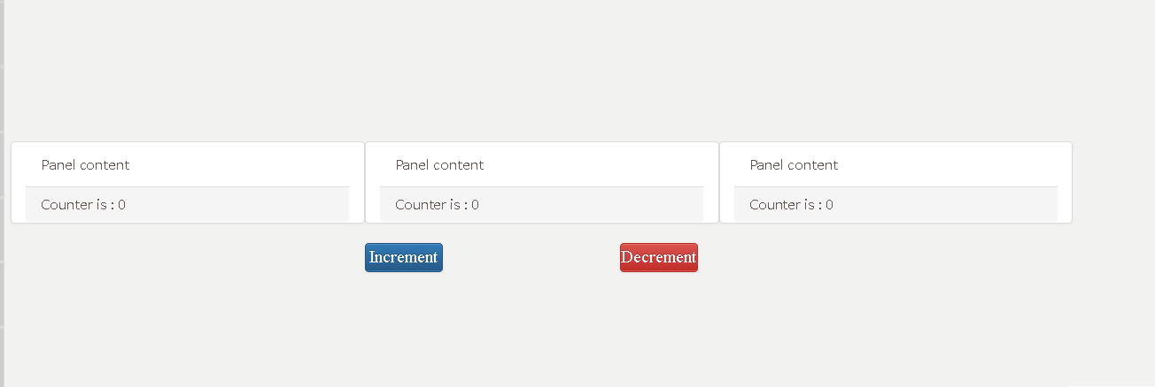
Let’s say we want to create this...

Slide 4
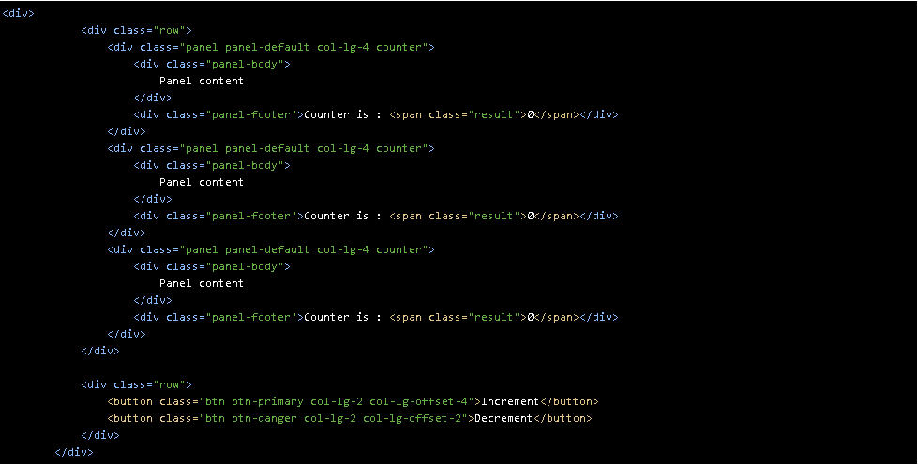
Let's go spaghetti... The HTML
Notes:
<div>
<div class="row">
<div class="panel panel-default col-lg-4 counter">
<div class="panel-body">
Panel content
</div>
<div class="panel-footer">
<div>
<label>By How Much?</label><input type="number">
</div>
Counter is : <span class="result">0</span>
</div>
</div>
<div class="panel panel-default col-lg-4 counter">
<div class="panel-body">
Panel content
</div>
<div class="panel-footer">
<div>
<label>By How Much?</label><input type="number">
</div>
Counter is : <span class="result">0</span>
</div>
</div>
<div class="panel panel-default col-lg-4 counter">
<div class="panel-body">
Panel content
</div>
<div class="panel-footer">
<div>
<label>By How Much?</label><input type="number">
</div>
Counter is : <span class="result">0</span>
</div>
</div>
</div>
<div class="row">
<button class="btn btn-primary col-lg-2 col-lg-offset-4 increment" >Increment</button>
<button class="btn btn-danger col-lg-2 col-lg-offset-2 decrement">Decrement</button>
</div>
</div>

Slide 5
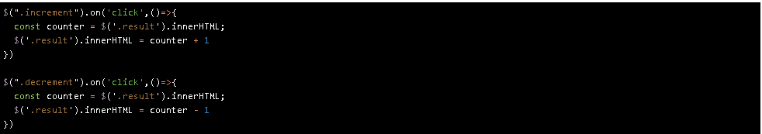
Let's go spaghetti in JQUERY
But!!!

Slide 6
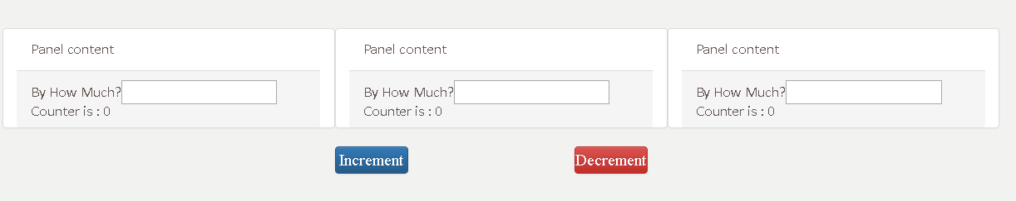
What if we want the user to decide how much to increment?

Slide 7
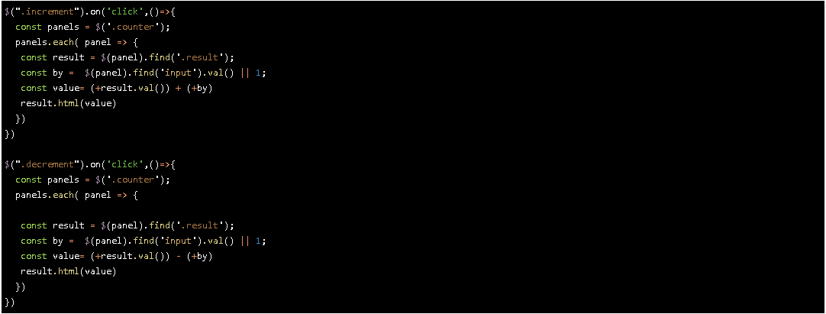
Let’s go spaghetti and do more

Slide 8
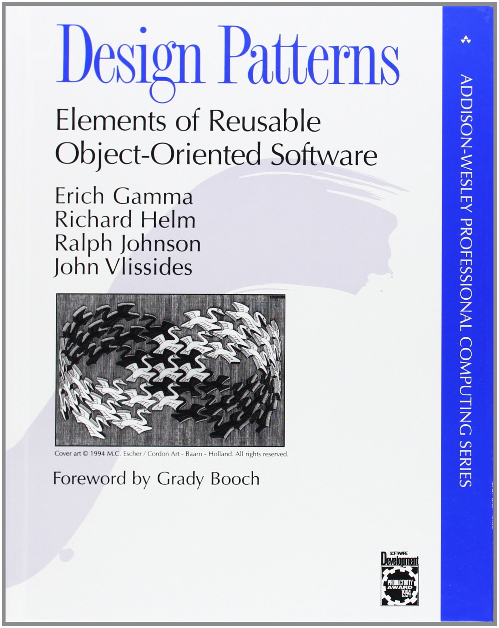
Spaghetti code cannot be maintained!!!!
Luckily for us,
Design pattern is for the rescue
Javascript main design patterns
Prototype
Factory
Module
Observable
Singleton
The gang of 4

Slide 9
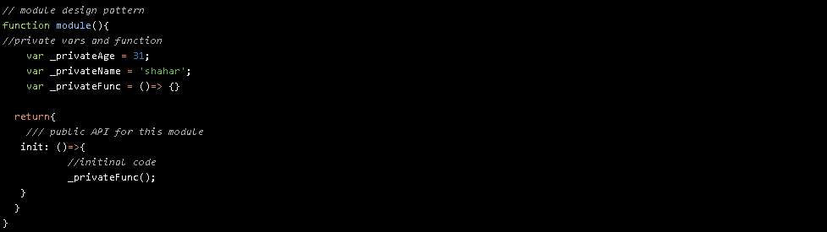

Let's go module pattern!

Slide 10
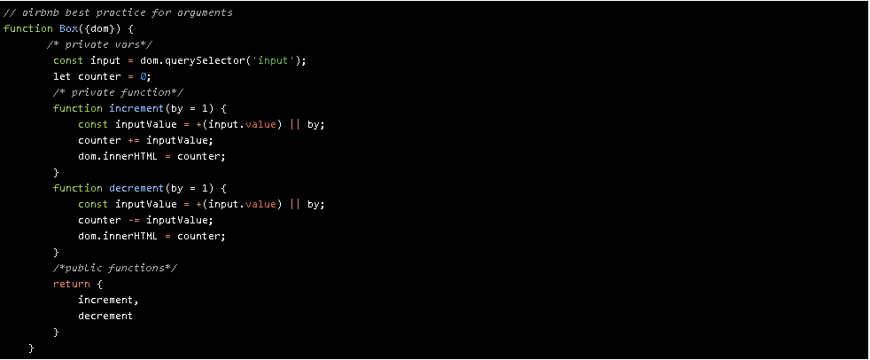
From Spaghetti to Module
Notes:
// airbnb best practice for arguments
function Box({dom}) {
/* private vars*/
const input = dom.querySelector('input');
let counter = 0;
/* private function*/
function increment(by = 1) {
const inputValue = +(input.value) || by;
counter += inputValue;
dom.innerHTML = counter;
}
function decrement(by = 1) {
const inputValue = +(input.value) || by;
counter -= inputValue;
dom.innerHTML = counter;
}
/*public functions*/
return {
increment,
decrement
}
}

Slide 11
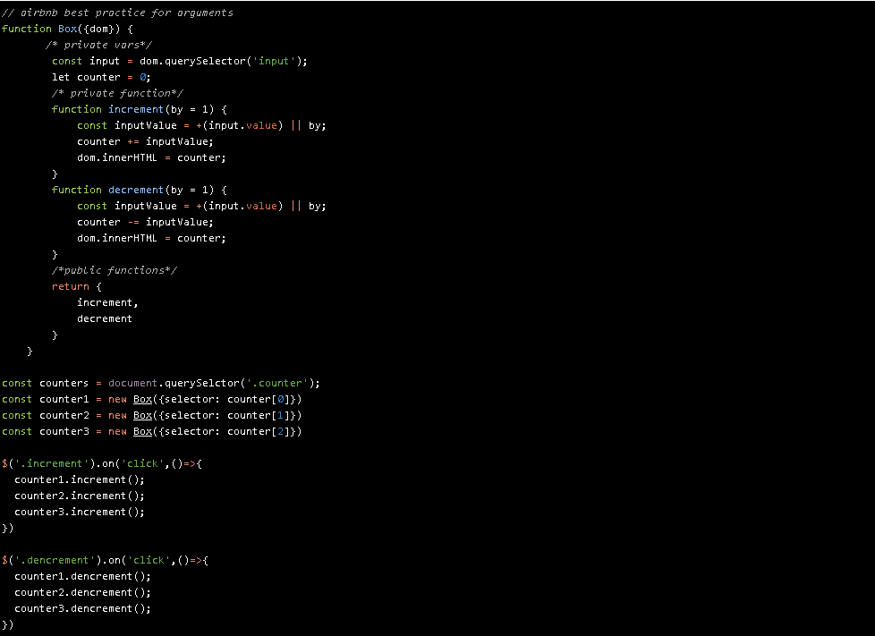

Let's use our module in the right way
Notes:
// airbnb best practice for arguments
function Box({dom}) {
/* private vars*/
const input = dom.querySelector('input');
let counter = 0;
/* private function*/
function increment(by = 1) {
const inputValue = +(input.value) || by;
counter += inputValue;
dom.innerHTML = counter;
}
function decrement(by = 1) {
const inputValue = +(input.value) || by;
counter -= inputValue;
dom.innerHTML = counter;
}
/*public functions*/
return {
increment,
decrement
}
}
const counters = document.querySelctor('.counter');
const counter1 = new Box({selector: counter[0]})
const counter2 = new Box({selector: counter[1]})
const counter3 = new Box({selector: counter[2]})
$('.increment').on('click',()=>{
counter1.increment();
counter2.increment();
counter3.increment();
})
$('.dencrement').on('click',()=>{
counter1.dencrement();
counter2.dencrement();
counter3.dencrement();
})

Slide 12
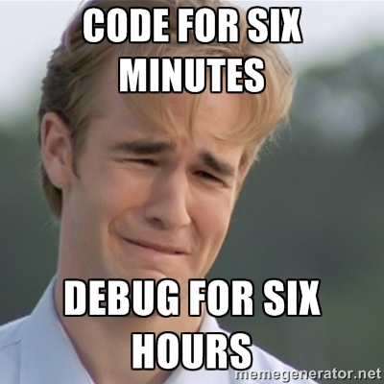
Houston,
we have a problem
To
Maintain
this

Slide 13


Let’s meet our friend,
Observable pattern. (Pub/Sub)

Slide 14
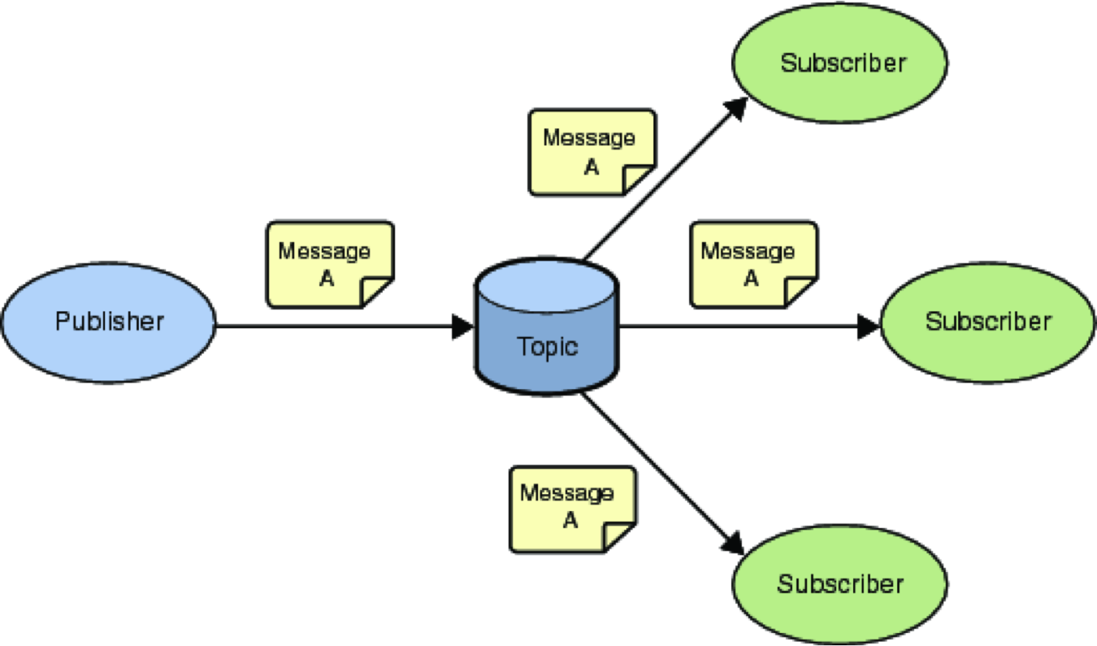
What is pub/ sub pattern
Like twitter
The celeb posts his tweet
The subscriber gets the push
Every publisher can have as many followers as he wants

Slide 15
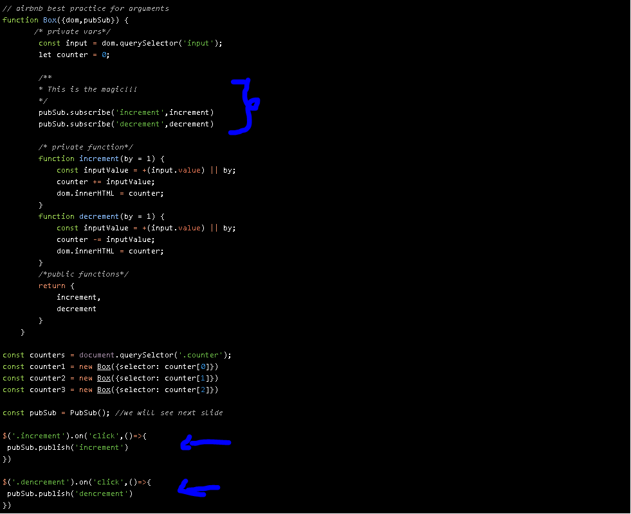
Let’s go pub/sub….

Slide 16
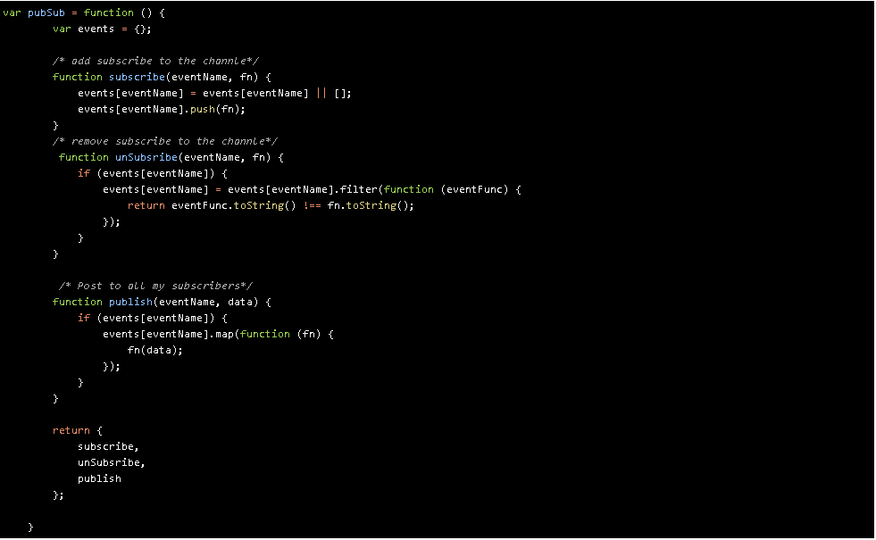
Show me the code.. (only 25 lines of code, with {})

Slide 17

What did I see right now...

Slide 18
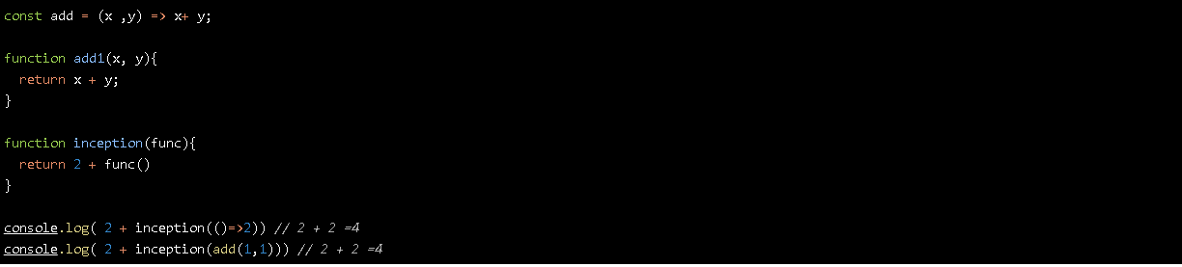
You passed a function to an array?!?!
You called a function from an array?!?!
WTF
In javascript, everything is data, and we can pass functions as referenced data as well

Slide 19
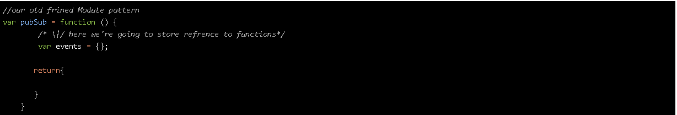
Let’s build from scratch
Hey, I know you
You are the module pattern

Slide 20
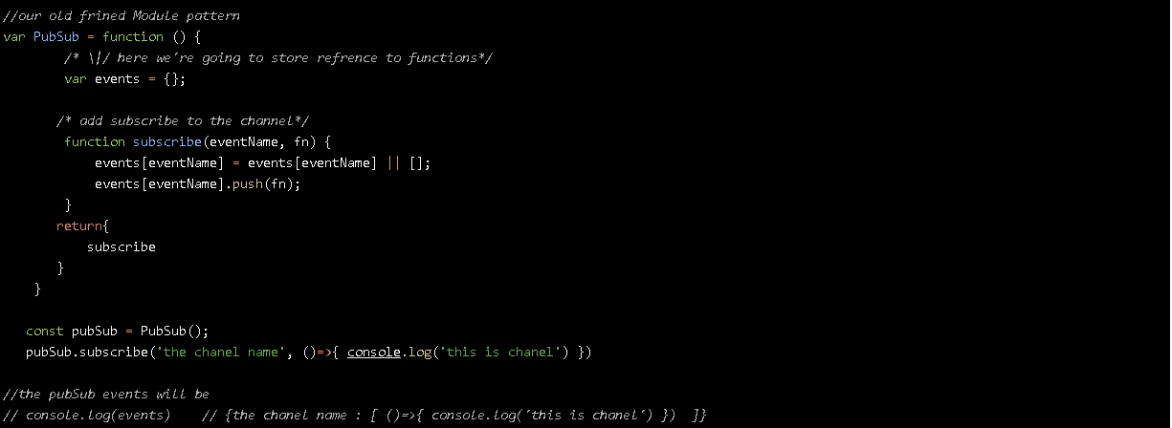
Let’s add some followers (subscribers)
With the method subscribe we will add function to the array of this channel
If the channel name exists now, we will create a new array instance.
If he does, we will push to the stack the function reference
If not exist make new array instance as default

Slide 21
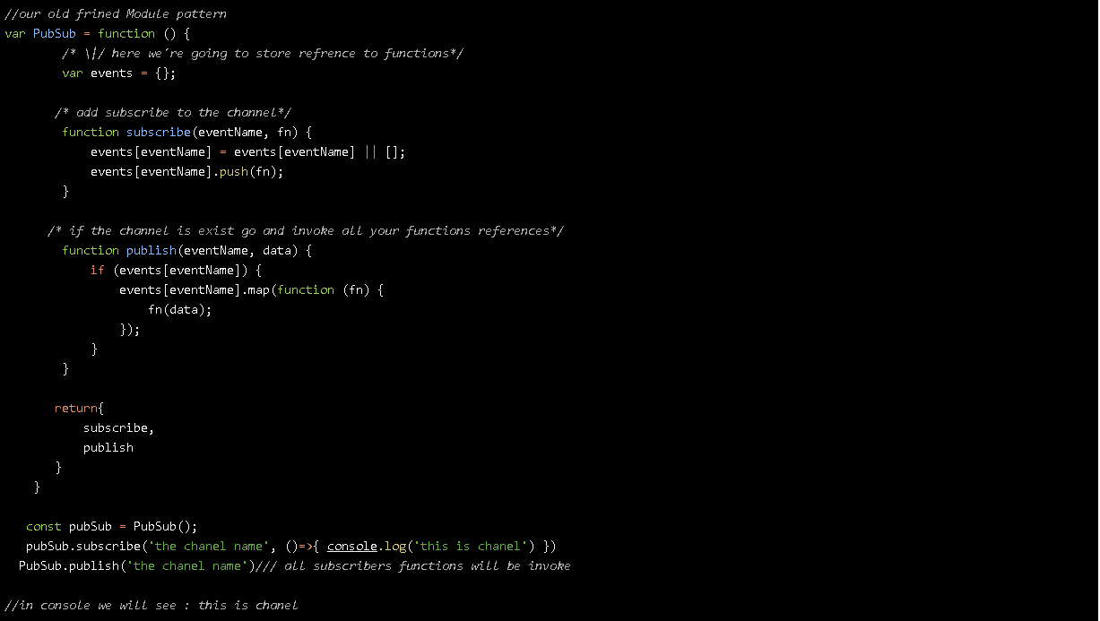
Let’s publish something to our followers
Event name and passed data to
the functions

Slide 22
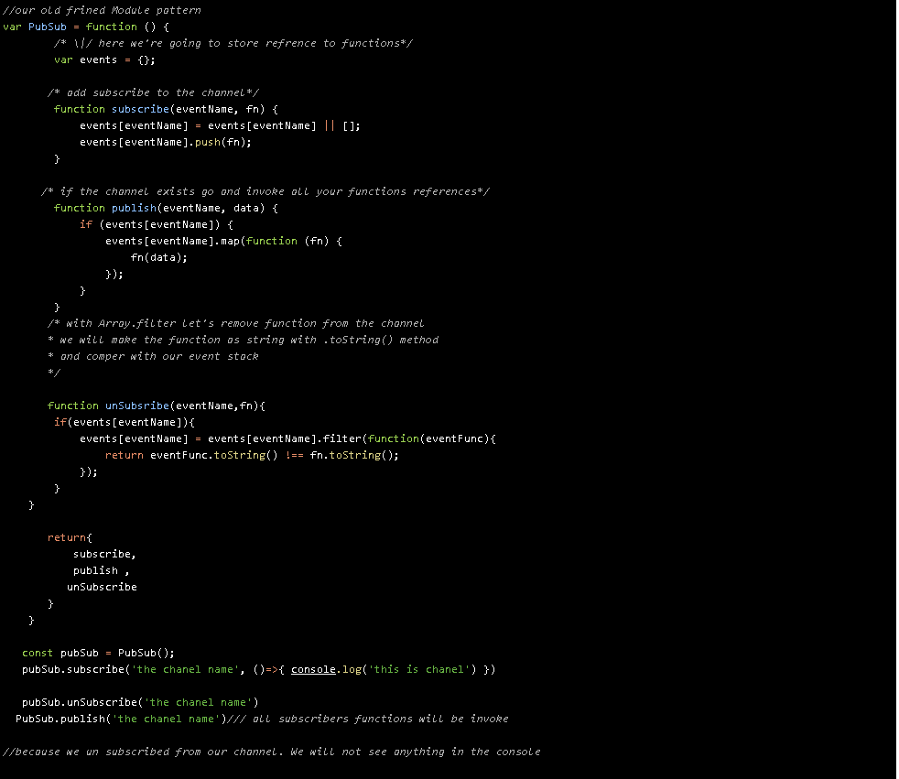
Let’s delete us from our publisher
Before anything’s published, and we unsubscribe
from the channel, we will see nothing.

Slide 23
What’s next ?
Anything
With
x
Our evolution is RxJs
Angular NgRx
React Redux
Vue Veux
Reactive Programming

